Slide 1
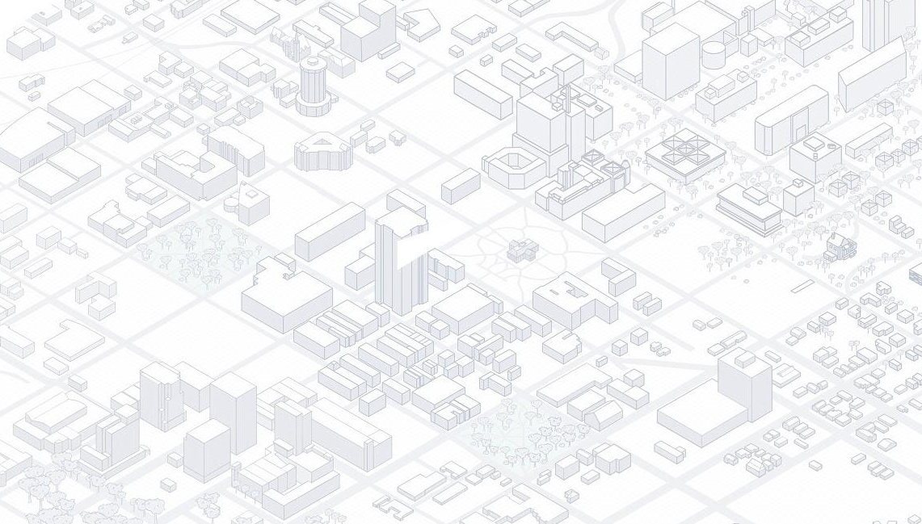

Tamilthaaragai Muthukumar - Nupur Mallik - Nithya Pari
Viralkumar Sanghavi - Haizhou Wu

Slide 2
Existing Problem
First time tourists depend on travel and navigation mobile apps for exploring a new city like Raleigh.
Current apps just list down data pulled from Google Maps and does not give a personal user experience
There is not much difference between using Google maps to find places and these apps that suggest popular spots to visit
Current apps give information but there is no fun exploring the city.

Slide 3
Solution
Bucket List Raleigh - An interactive way of exploring the city.
Isometric view of map makes exploring the city exciting and fun
Colorful highlights of buildings in Map based on category selected - Highlights the important spots that may not be a tourist spot but enjoyed by local Raleigh residents
Interactive map allows user to explore Raleigh downtown by zooming in and out and getting an idea about each building.
Fun aspect - Doodle on buildings using a multi-color palette

Slide 4
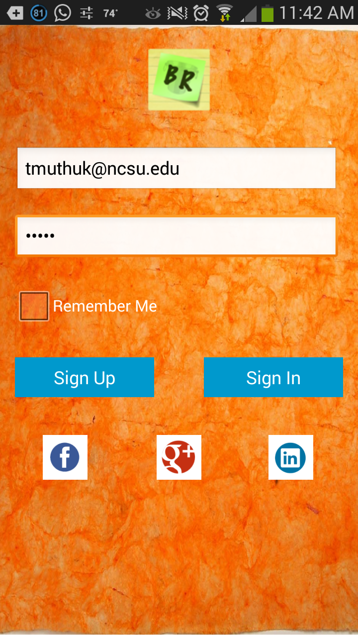
Features
Colorful highlighted buildings based categories - Food, Fun and Drink
Add Reviews
User profile
Doodle on the map
Scrollable Image gallery with photos of the places
Sticky Note theme to view building details

Slide 5
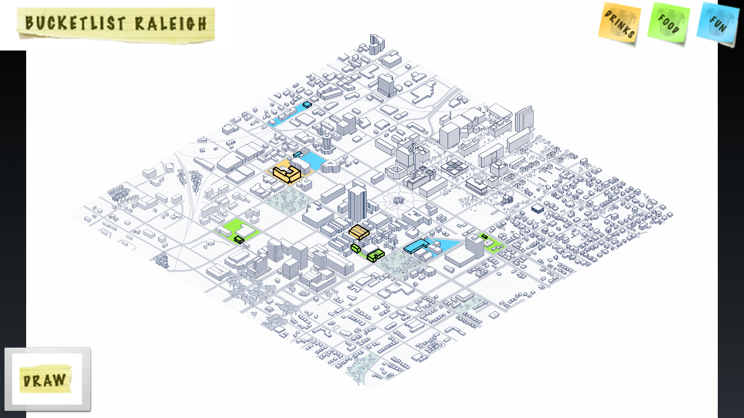
Loosen up yourself without getting lost
Explore downtown Raleigh
Isometric view of map
Zoom in and zoom out to take a closer look of the buildings.
Offline access

Slide 6
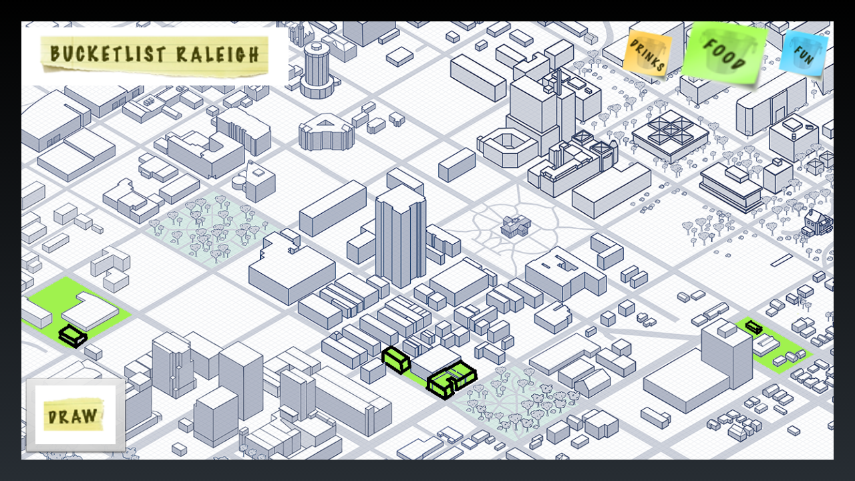
Enjoy famous sights and hidden gems
Categorization of the selected places around Raleigh
Color coded Icons at the top represents them
Click on it !! Shows the places that come under that category.
Once user clicks one of those three buttons, clickable buildings will be highlighted on the map based on the filter selected

Slide 7
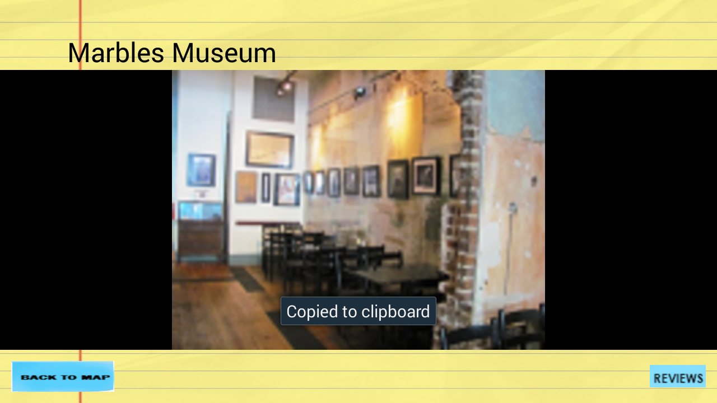
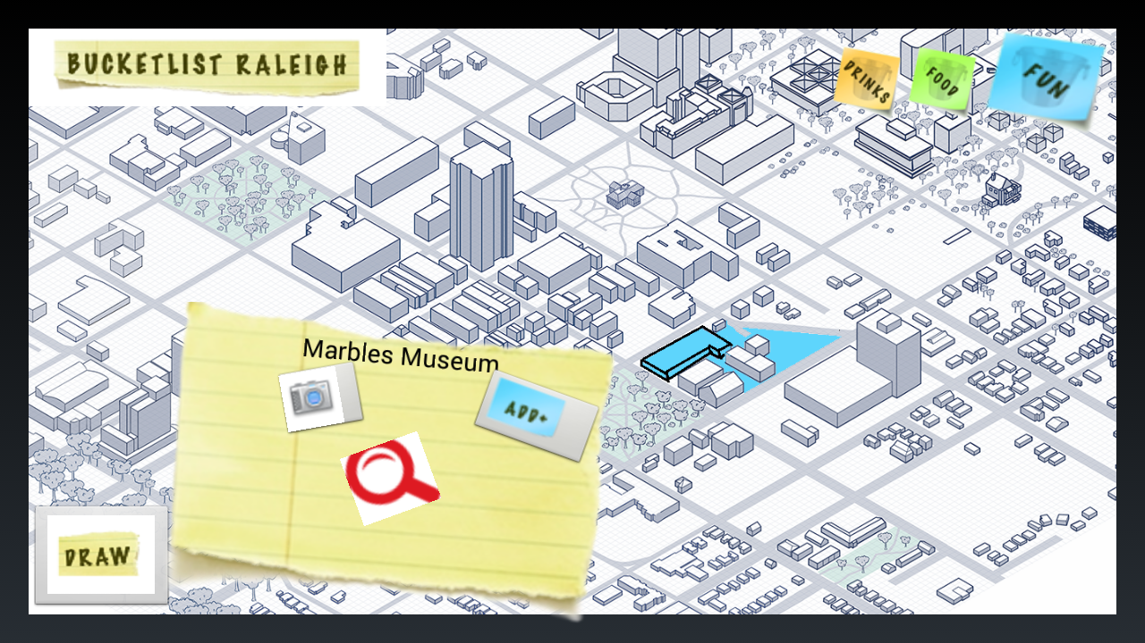
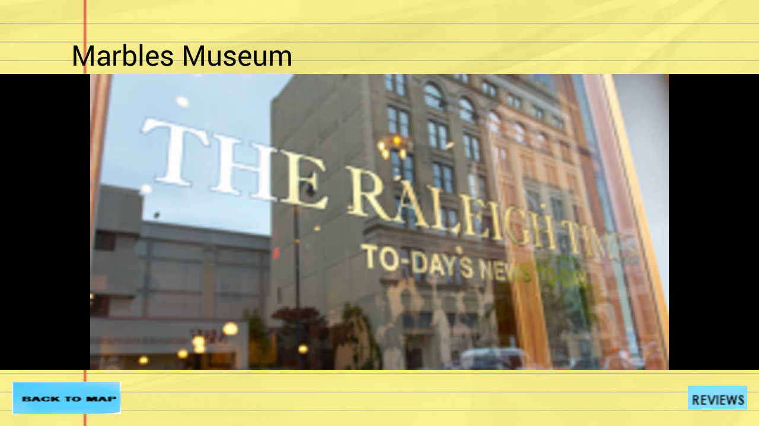
Smart planning of self-guided tours
Sticky note popup with options to explore each building
Beautiful Image gallery that allows users to swipe and see all pictures of the building
Options to move on to reviews of the building or
Photos - View a snapshot of the locations you want to visit

Slide 8
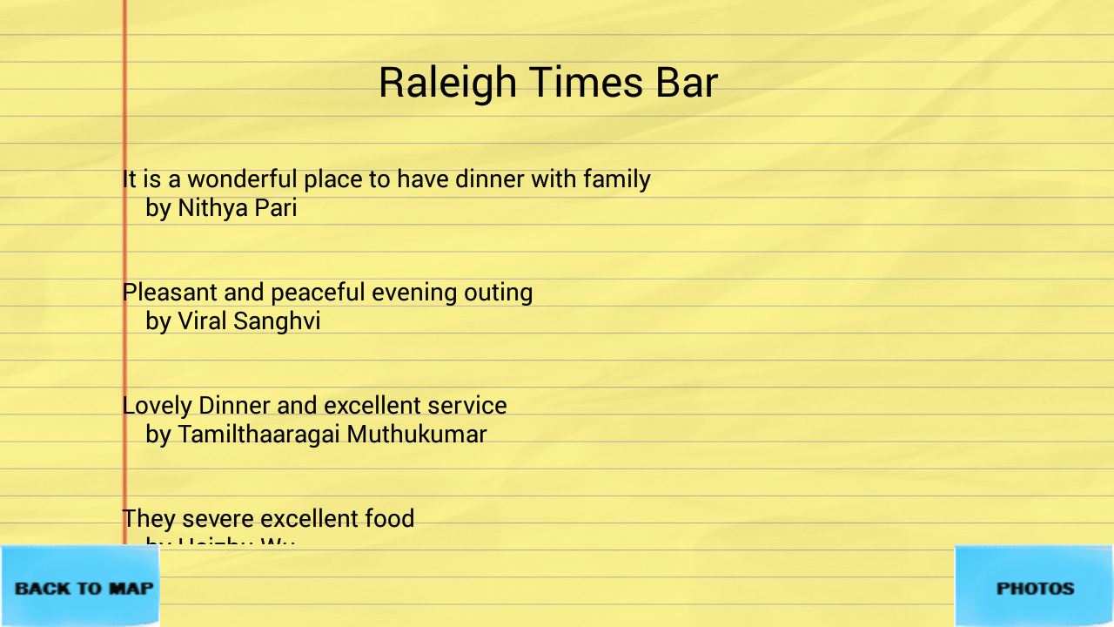
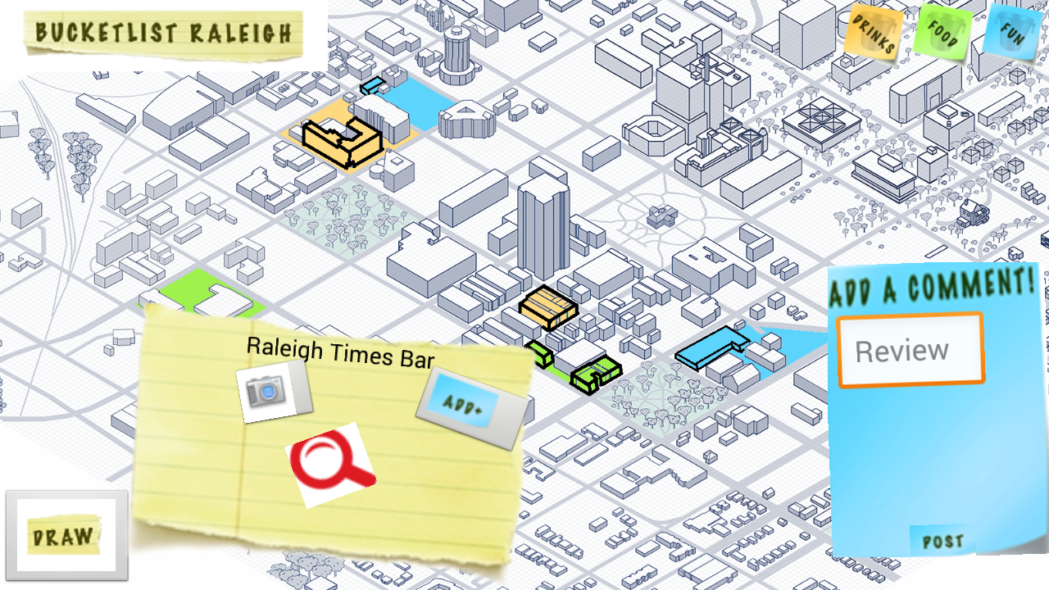

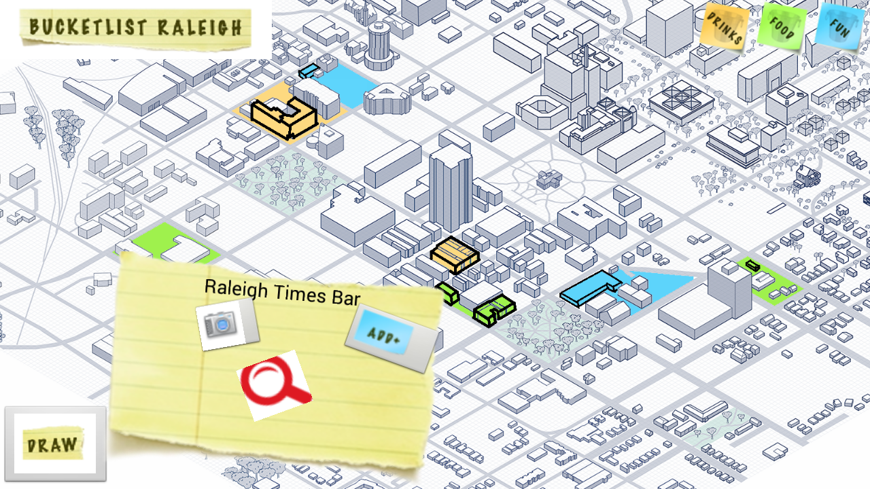
Peer recommendation
User can sign in/sign up to create a new account in order to post reviews with other users.
Add Review option allows users to post their review based on his or her personal experience.
New reviews get appended to existing reviews
Scrolling option to view more reviews at the end

Slide 9
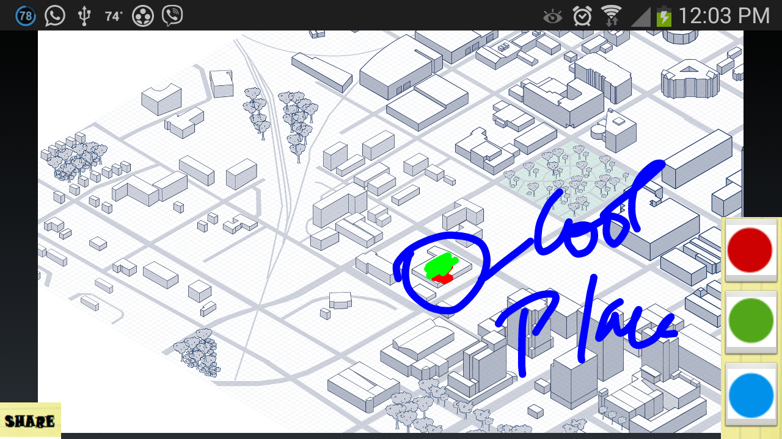
Map Image can be personalized
User can to draw colored paths and highlight buildings on the map.
Doodling made possible on zoomed in map
No need to wait for GPS directions, just draw your own directions to share with friends.
Free yourself of waiting and searching for GPS directions.
Show to friends the direction of a meetup or dinner / draw out a meeting spot as a reminder.

Slide 10
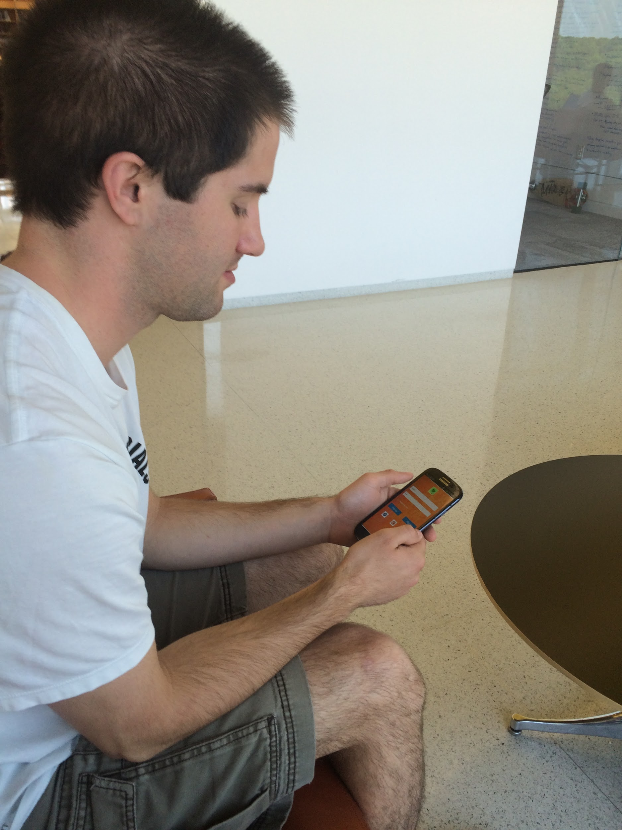
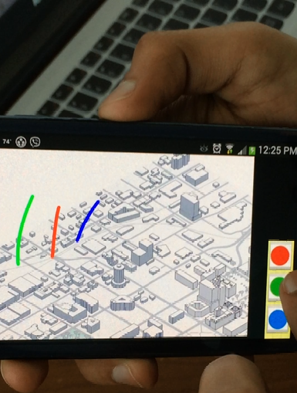
End User Evaluation
General feedback was that the design was fun and appealing to them
Look and feel of the app was appreciated
Doodling on map was loved by users
Sliding image gallery was user friendly

Slide 11
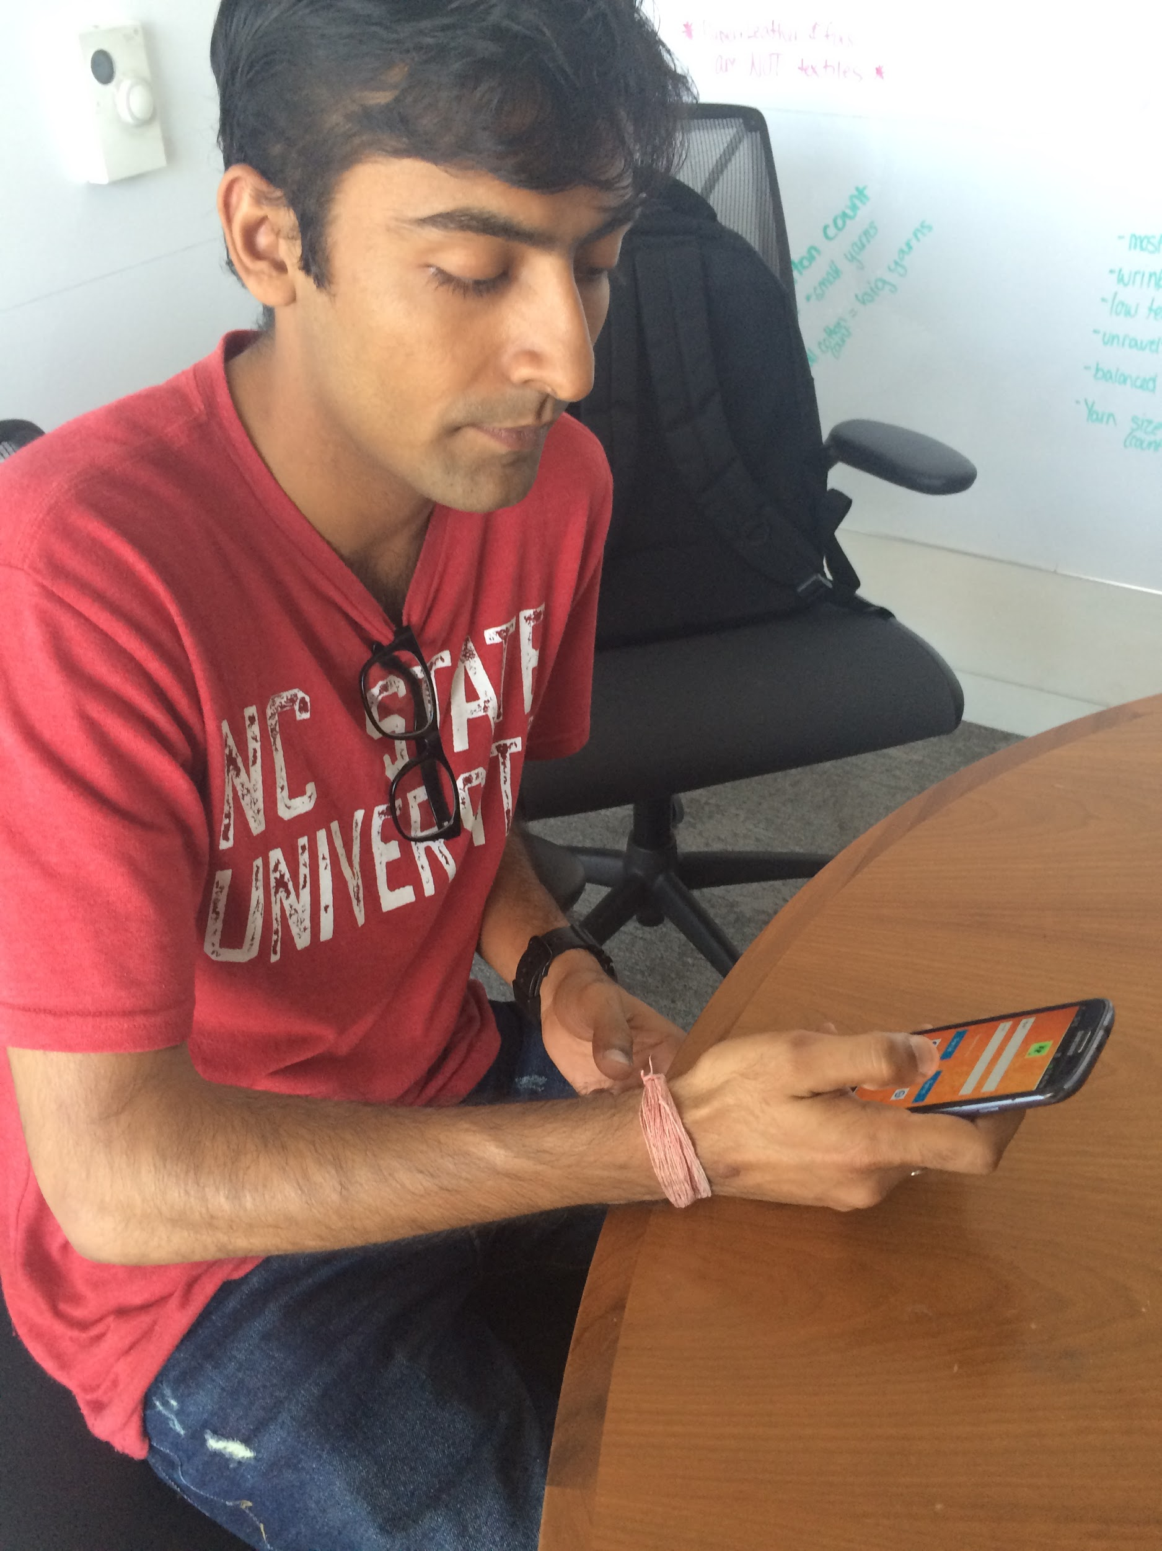
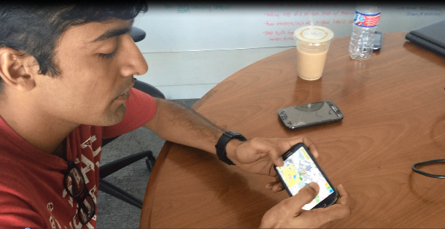
End User Evaluation
123
Application was slow sometimes
Tiny crashes happened due to ‘Memory overflow’
We are planning to fix these

Slide 12
Demo And Future Roadmap
Handle memory management in a better way
Extend the concept to other cities
Upvote/downvote a place
Enhance doodling features
Enhance user interaction features such as adding pictures, adding more places to visit

Slide 13
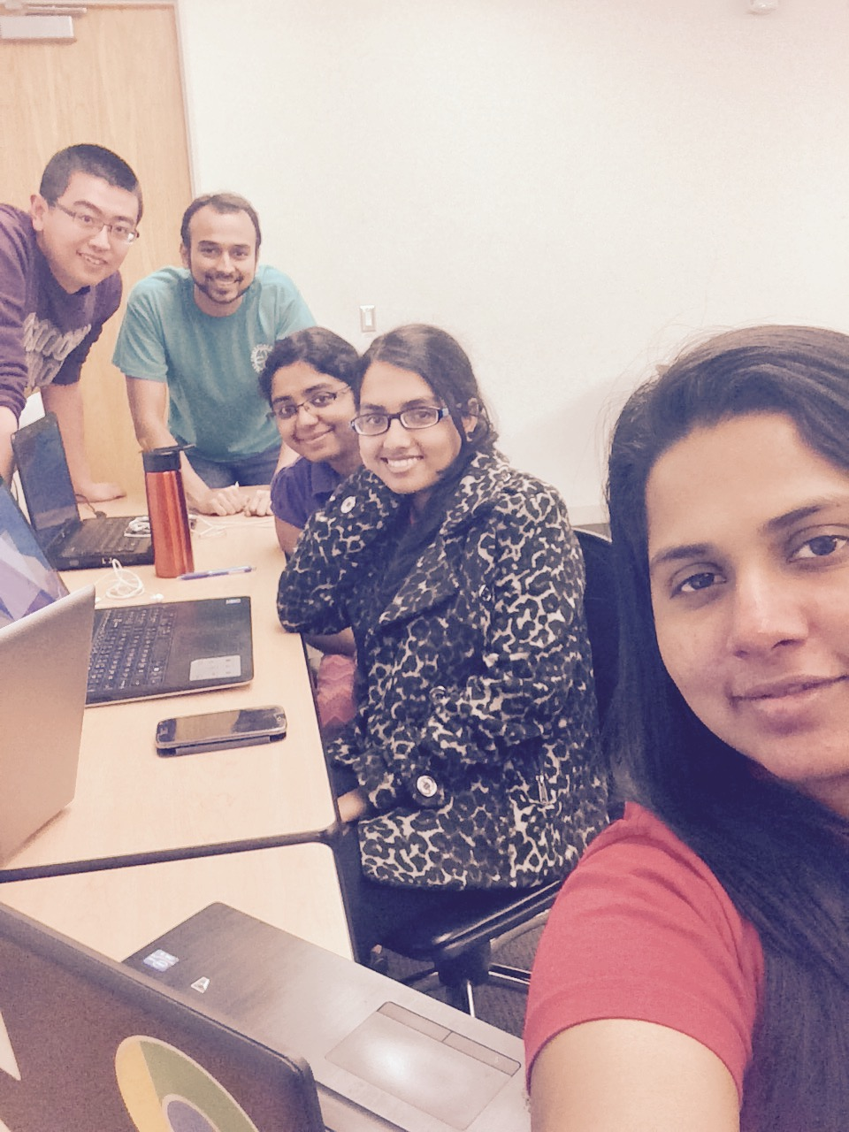

We had lot of fun!
Thank you :-)

